Slide 1
Booting from hard disk…
Starting Windos 95...
Press me

Slide 2


Slide 3
X

Slide 4
Coming soon
X
The dev has not made this feature yet!
Be patient!

Slide 5

Access denied
X
Your admin has denied access to this element of Windos.
Contact them about this if you still want to access it.

Slide 6
X

Slide 7

Email received
X
From:
Subject:

Slide 8

X

Slide 9

File Explorer
X

Slide 10
login
Username: username
Password: ********
Log in

Slide 11






Windos 95
Beta 1
For testing purposes only
What’s new:
Added icons for start menu items
Moved shortcuts to start menu
You can now click outside of the start menu to exit it
Added users directory
Added access to Windos directory
Added shell32 shortcut on taskbar
Added bin
Added up in explorer
Hint of version:
Click me to visit the official Windos website!
shell32

Slide 12
All apps
Explorer
Run
Find
Intranet explorer
Log off Username
Power off…
Shortcuts:
Explorer
Intranet
Email
Feedback
All apps

Slide 13
Power menu
X
Power off
Reboot
Log off
sleep

Slide 14
It is now safe to turn off your computer.
Restart
Press ESC to exit Windos now

Slide 16




All apps
X
Intranet explorer
Sticky notes
Minecraft
email
explorer
Fortnite

Slide 17
Intranet explorer 16- CONNECTED
X
Welcome to the Intranet!
Tap on any of the underlined text to open that website!
Windos official site
Google
Bing
Ask Jeeves

Slide 18

File Explorer
X
My computer
C:\

Slide 19
run
X
osod.exe
✓
X

Slide 20
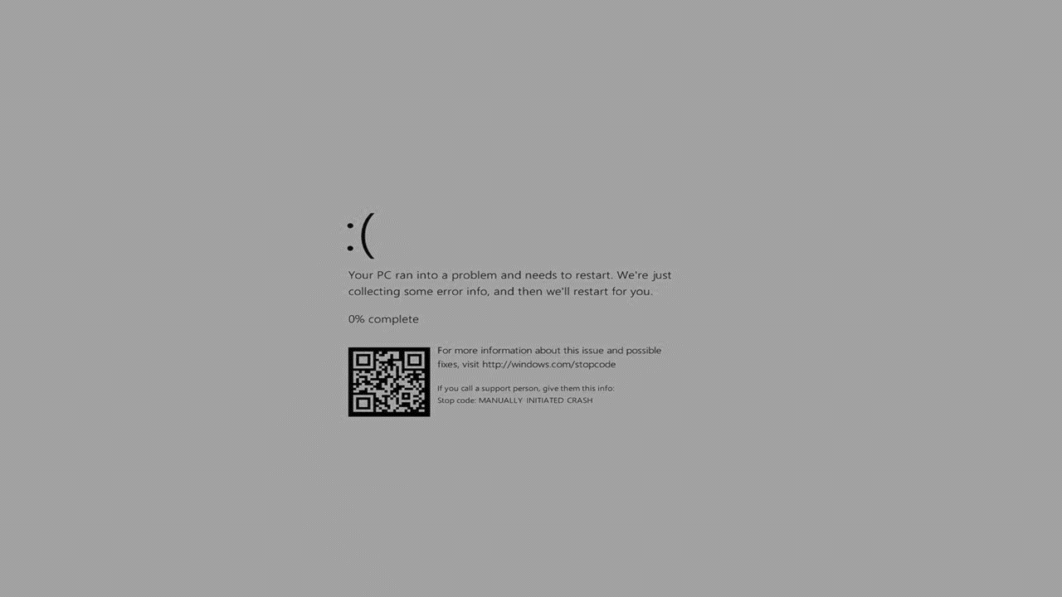

Slide 21

find
X
osod.exe
Found 1 file:
osod.exe
Press the button to open file

Slide 22

File Explorer
X
C:\
Windos
Program files
Users
Windos.dll

Slide 23
Access denied
X
This PC has denied access to this file or folder.
Please contact the developer of Windos for ,more info.

Slide 24
Windos.com
X
Windos official site!
Welcome to the official site of Windos!
The latest official build is Windos 3 v1.01 but you can get Windos 95 alpha 3!
request a copy!
Feedback
Contact the developer

Slide 25
Windos. Com/copyrequest.html
X
Copy request:
Windos official site!
Windos 1 latest
Windos 2 latest
Windos 3 latest
Windos 95 latest alpha
Windos 95 waiting list
Request all Windos 1
Request all Windos 2
Request all Windos 3

Slide 26

Minecraft
X

Slide 27



Ew this game sucks
X

Slide 28
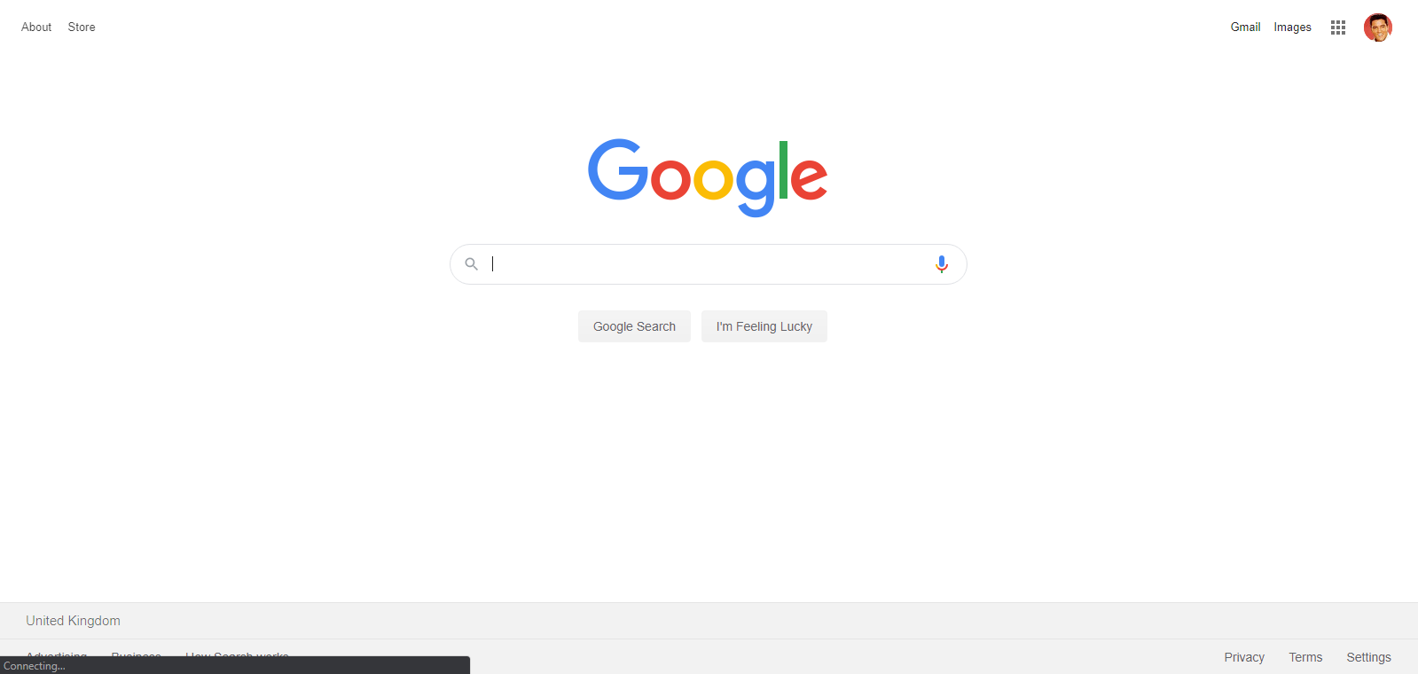
Google.com
X
Welcome to an archive of Google.com from 03/06/2020

Slide 29

Bing.com
X
As of 3/6/2020

Slide 30

Ask-jeeves.com
X

Slide 31
Email client 1.00
X
From szymonmochort11@gmail.com
Welcome!
Please do select an email to read if you see the index finger cursor when you hover over it!

Slide 32
Email received
X
From: szymonmochort11@gmail.com
Subject: the official website
Click to be redirected to the:
Official site here
© 2020 Windos corporation. All rights reserved.

Slide 33
File Explorer
X
C:\windos
system32
Shell32.dll

Slide 34









All icons in this OS-not clickable
X

Slide 35
File Explorer
X
C:\users
main1
main2
guest
admin

